Slide 1
The Allocation of School Zone for ISDs in DFW Region
Zhen ding, Hua Yang
Model Development and Data Management Group
North Central Texas Council of Governments

Slide 2
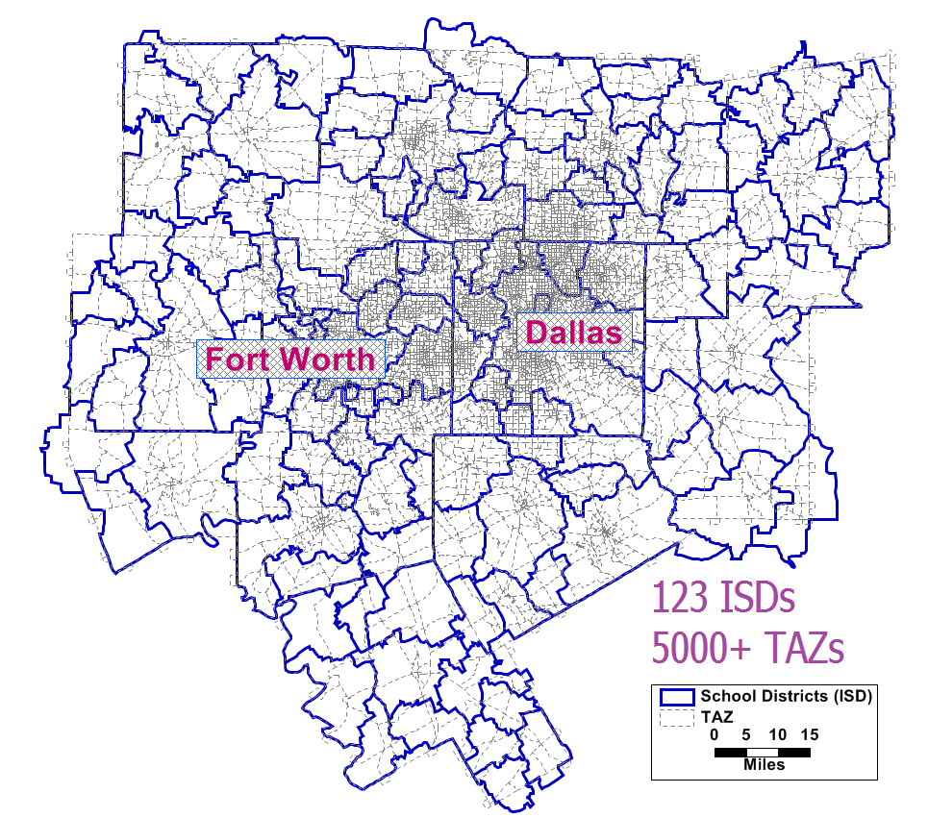
Quick Facts of NCTCOG
Dallas - Fort Worth and 13 Counties
6.9 Million Population
123 ISDs, 1,323 Public K-12 Schools,
90% students attend public schools *
* National Center for Education Statistics, 2018

Slide 3
Highway vs My Way
Traditionally
Conduct survey (trips, # of children…)
Estimate trip rates
Distribute trips (gravity model)
This time, different
ISD and school locations
Allocate school zones (regional partition)
Trip distributed, simultaneously

Slide 4
What is “regional partition”?
RP aims at creating a group of features based on proximity or similarity
The solution are districts that are contiguous, compact, and balanced
A national wholesaler to defines its 5 regional distribution centers’ service districts, balanced by population.
Allocation of States for Five Distribution Center
Chart adapted from TransCAD <<Routing & Logistics User Guide>>

Slide 5
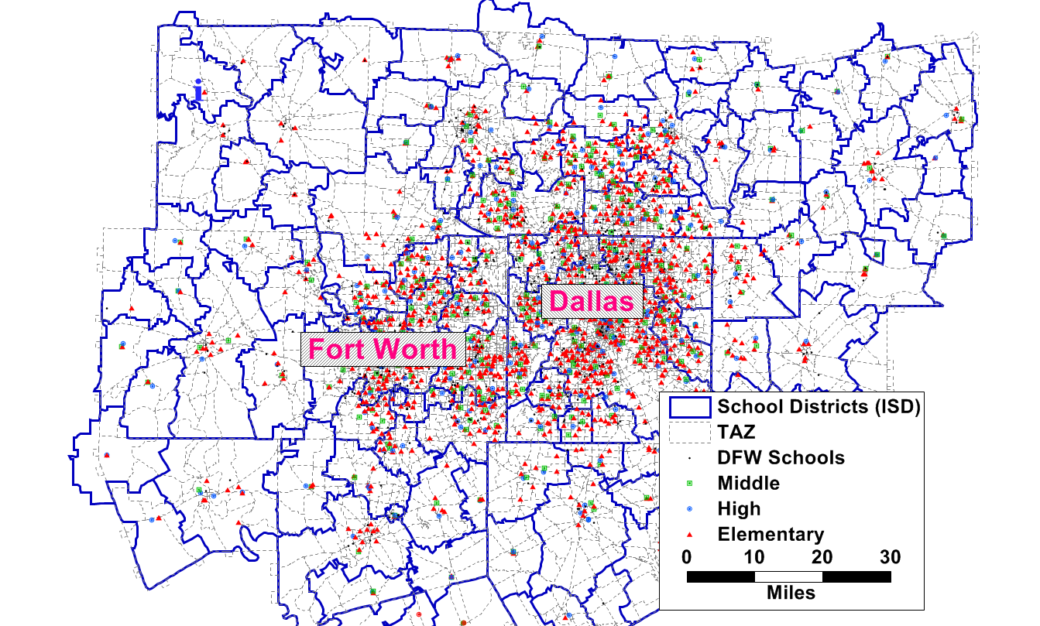
DFW ISD & Public Schools
The Objective
For each school, a surrounding compact area needs to be defined as its school zone.
A school zone usually consists of multiple TAZs.

Slide 6
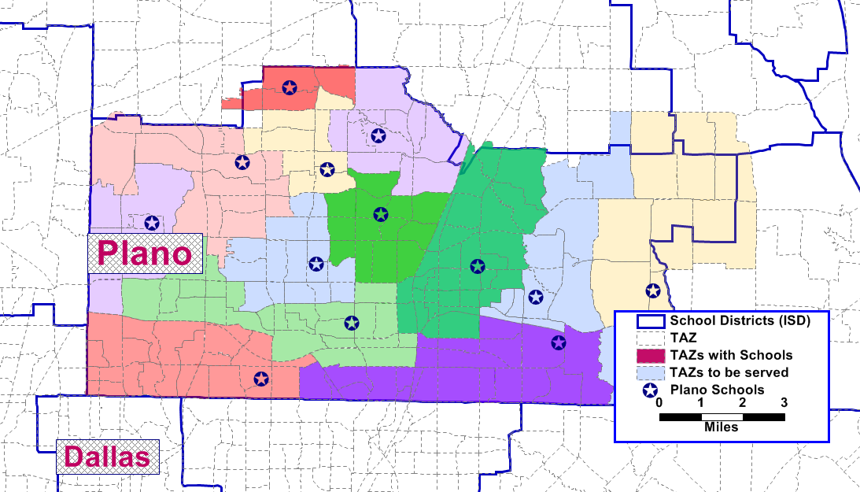
Solution of School Zone Allocation
School Zones of Plano ISD

Slide 7
Summaries
Benefits
Existing data
More realistic and accurate
Flexibility in model development and application
Potential reference for decision makers in future

Slide 8
Questions?

